Slide 1

Chapter 6
Data Encryption Standard (DES)
Copyright © The McGraw-Hill Companies, Inc. Permission required for reproduction or display.

Slide 2
Chapter 6
Objectives
❏ To review Feistel Cipher
❏ To define the basic structure of DES
❏ To describe the details of building elements of DES
❏ To describe the round keys generation process
❏ To analyze DES

Slide 3
5.1.4 Product Ciphers
Shannon introduced the concept of a product cipher. A product cipher is a complex cipher combining substitution, permutation, and other components discussed in previous sections.

Slide 4

5.1.4 Continued
Diffusion
The idea of diffusion is to hide the relationship between the ciphertext and the plaintext.
Note
Diffusion hides the relationship between the ciphertext and the plaintext.

Slide 5
5.1.4 Continued
Confusion
The idea of confusion is to hide the relationship between the ciphertext and the key.
Note
Confusion hides the relationship between the ciphertext and the key.

Slide 6
5.1.4 Continued
Rounds
Diffusion and confusion can be achieved using iterated product ciphers where each iteration is a combination of S-boxes, P-boxes, and other components.

Slide 7
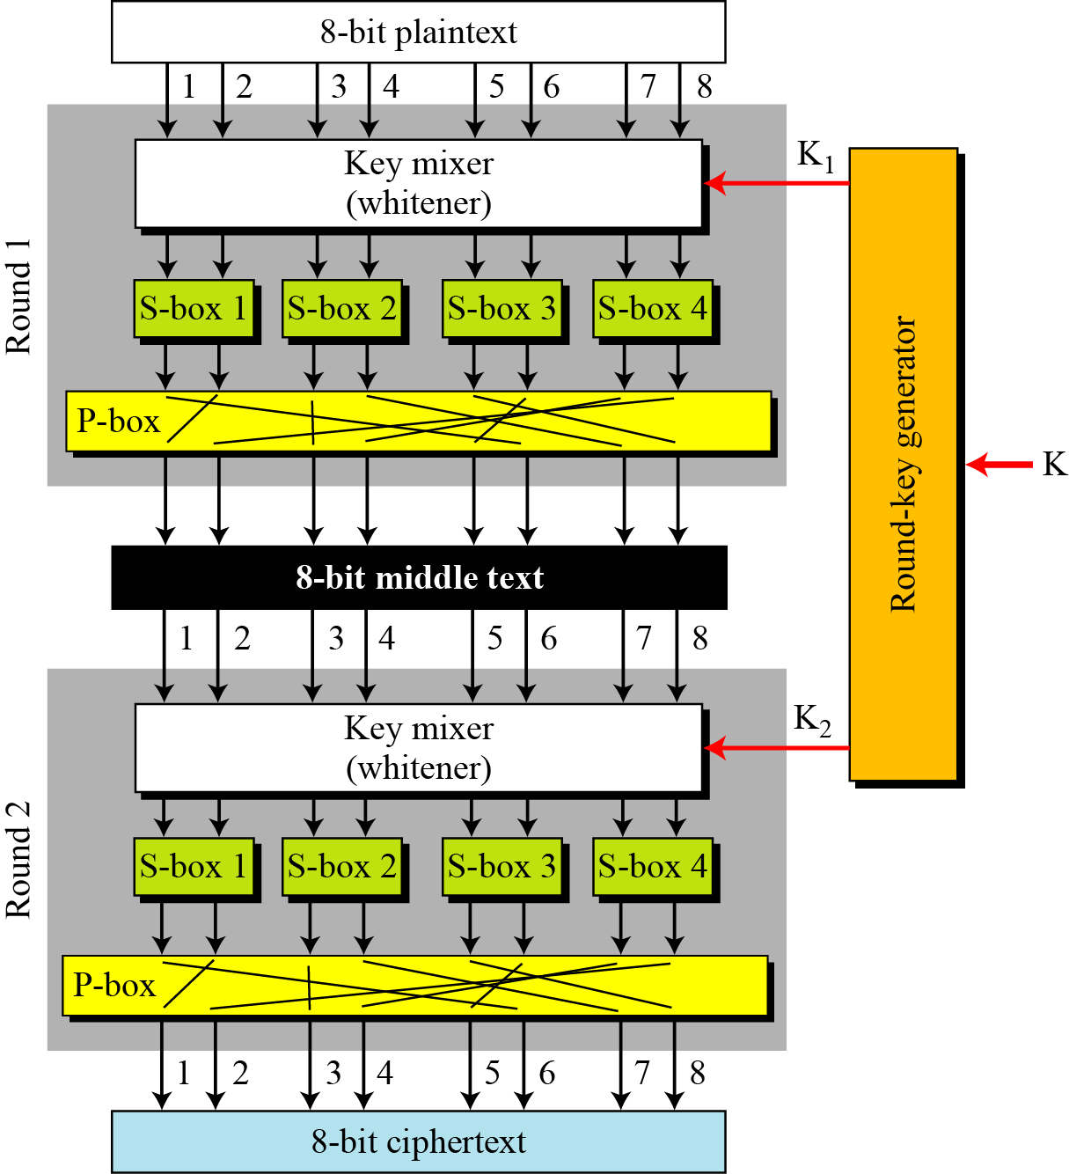
5.1.4 Continued
Figure 5.13 A product cipher made of two rounds

Slide 8
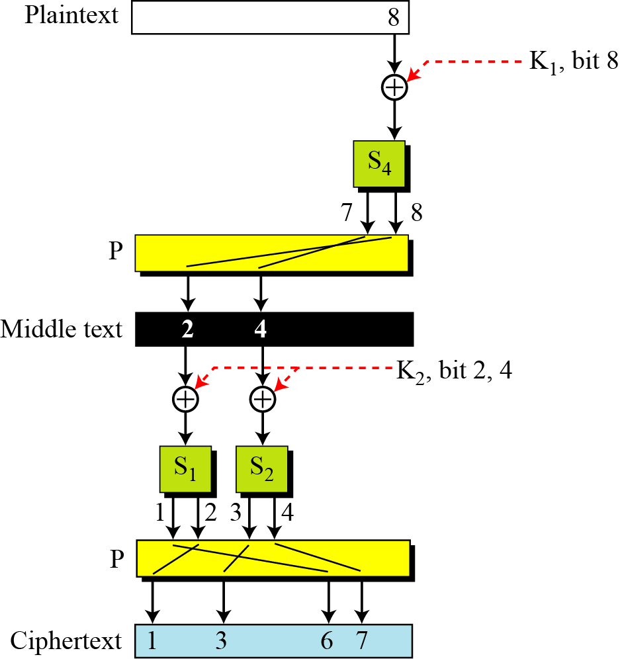
5.1.4 Continued
Figure 5.14 Diffusion and confusion in a block cipher

Slide 9
5.1.5 Two Classes of Product Ciphers
Modern block ciphers are all product ciphers, but they are divided into two classes.
1. Feistel ciphers
2. Non-Feistel ciphers

Slide 10
5.1.5 Continued
Feistel Ciphers
Feistel designed a very intelligent and interesting cipher that has been used for decades. A Feistel cipher can have three types of components: self-invertible, invertible, and
noninvertible.

Slide 11
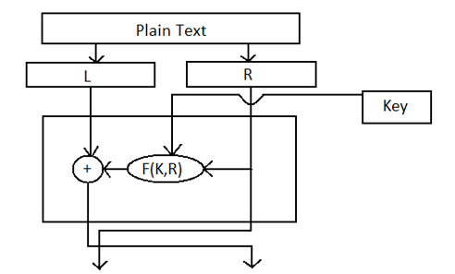
Feistel Cipher
Cipher text
F= Round function

Slide 12
6-1 INTRODUCTION
The Data Encryption Standard (DES) is a symmetric-key block cipher published by the National Institute of Standards and Technology (NIST).
Topics discussed in this section:
6.1.1 History 6.1.2 Overview

Slide 13
6.1.1 History
In 1973, NIST published a request for proposals for a national symmetric-key cryptosystem. A proposal from IBM, a modification of a project called Lucifer, was accepted as DES. DES was published in the Federal Register in March 1975 as a draft of the Federal Information Processing Standard (FIPS).

Slide 14
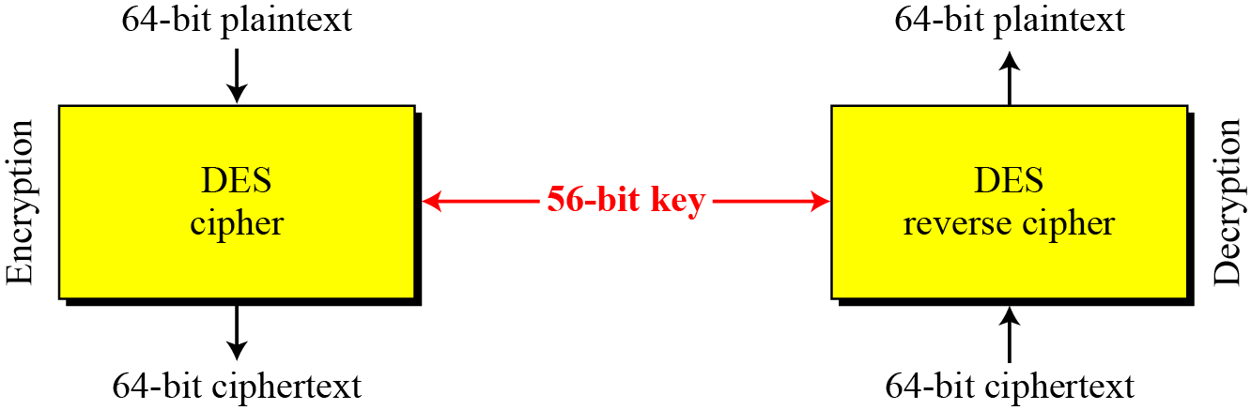
6.1.2 Overview
DES is a block cipher, as shown in Figure 6.1.
Figure 6.1 Encryption and decryption with DES

Slide 15
6-2 DES STRUCTURE
The encryption process is made of two permutations (P-boxes), which we call initial and final permutations, and sixteen Feistel rounds.

Slide 16
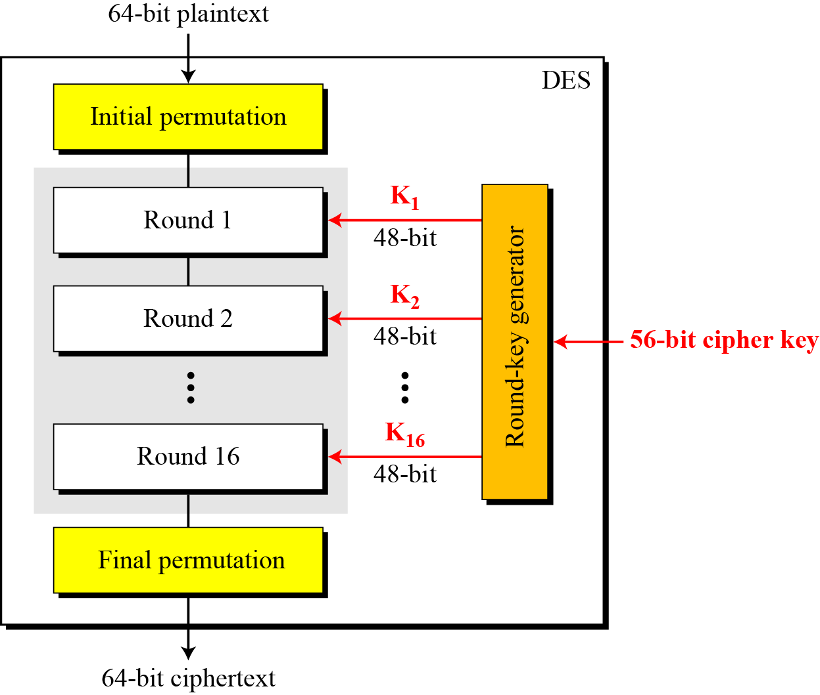
6-2 Continue
Figure 6.2 General structure of DES

Slide 17
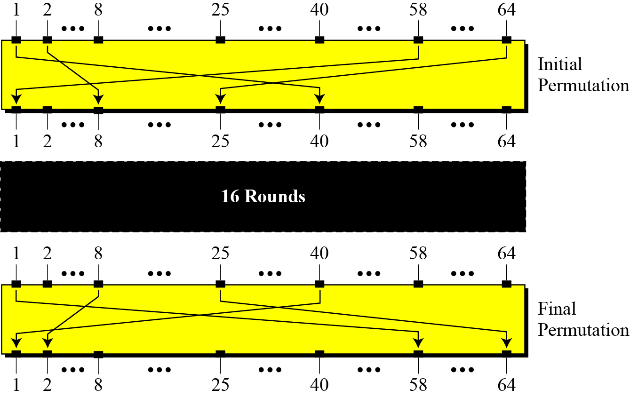
6.2.1 Initial and Final Permutations
Figure 6.3 Initial and final permutation steps in DES

Slide 18
6.2.1 Continue
Table 6.1 Initial and final permutation tables

Slide 19
6.2.1 Continued
Note
The initial and final permutations are straight P-boxes that are inverses of each other.
They have no cryptography significance in DES.

Slide 20
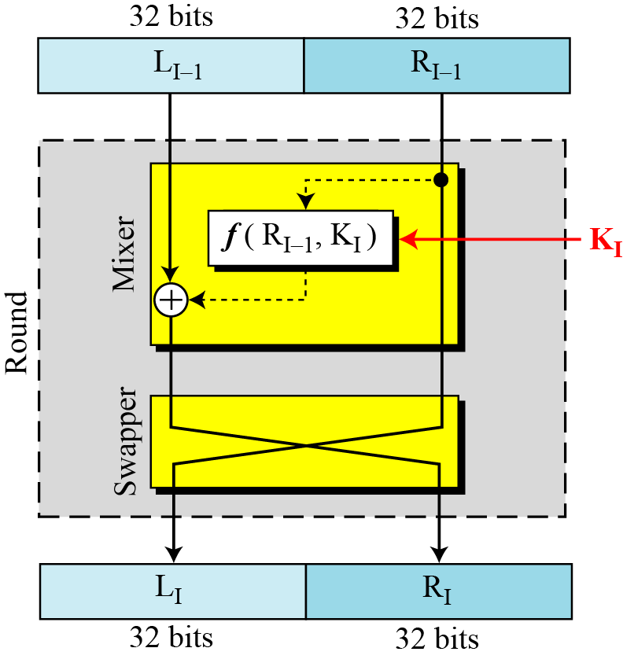
6.2.2 Rounds
DES uses 16 rounds. Each round of DES is a Feistel cipher.
Figure 6.4 A round in DES (encryption site)

Slide 21
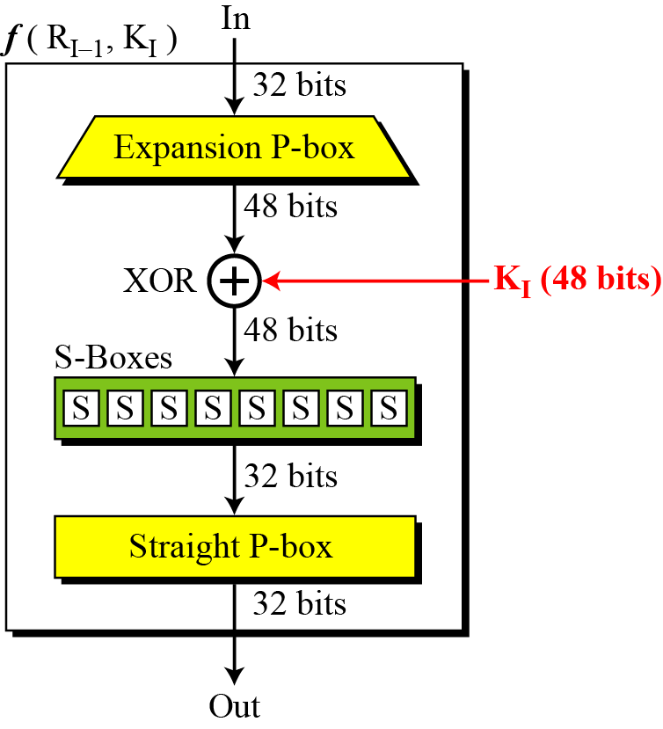
6.2.2 Continued
DES Function
The heart of DES is the DES function. The DES function applies a 48-bit key to the rightmost 32 bits to produce a 32-bit output.
Figure 6.5 DES function

Slide 22
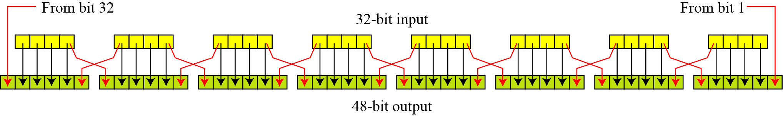
6.2.2 Continue
Expansion P-box
Since R_{I−1} is a 32-bit input and K_{I} is a 48-bit key, we first need to expand R_{I−1} to 48 bits.
Figure 6.6 Expansion permutation

Slide 23
6.2.2 Continue
Although the relationship between the input and output can be defined mathematically, DES uses Table 6.2 to define this P-box.
Table 6.6 Expansion P-box table

Slide 24
6.2.2 Continue
Whitener (XOR)
After the expansion permutation, DES uses the XOR operation on the expanded right section and the round key.
Note that both the right section and the key are 48-bits in length.
The round key is used only in this operation.

Slide 25
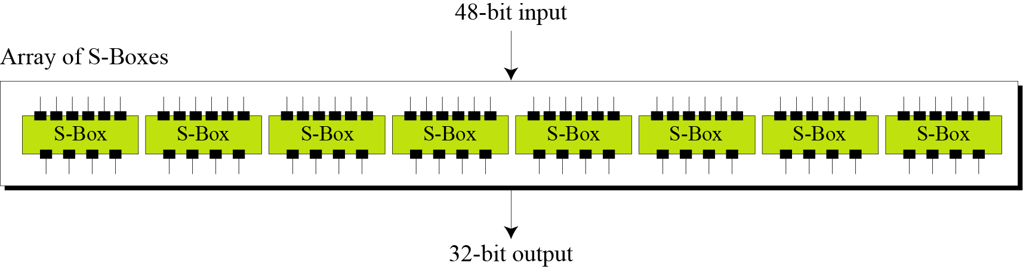
6.2.2 Continue
S-Boxes
The S-boxes do the real mixing (confusion).
DES uses 8 S-boxes, each with a 6-bit input and a 4-bit output.
Figure 6.7 S-boxes

Slide 26
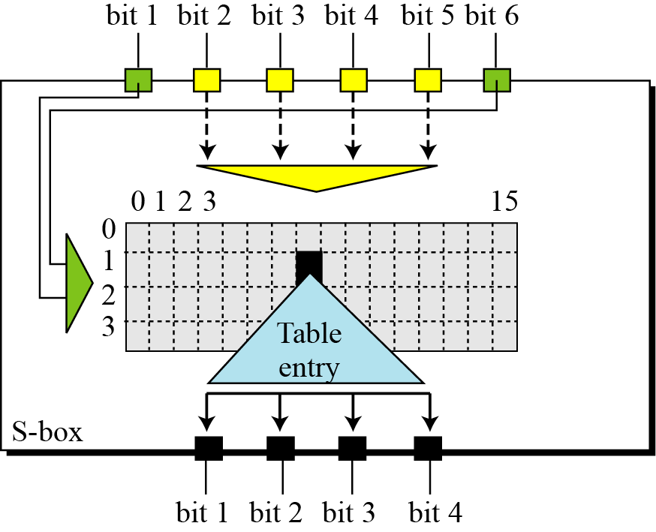
6.2.2 Continue
Figure 6.8 S-box rule

Slide 27
6.2.2 Continue
Table 6.3 shows the permutation for S-box 1.
Table 6.3 S-box 1

Slide 28
6.2.2 Continued
Example 6.3
The input to S-box 1 is 100011. What is the output?
Solution
If we write the first and the sixth bits together, we get 11 in binary, which is 3 in decimal. The remaining bits are 0001 in binary, which is 1 in decimal. We look for the value in row 3, column 1, in Table 6.3 (S-box 1). The result is 12 in decimal, which in binary is 1100. So the input 100011 yields the output 1100.

Slide 29
6.2.2 Continued
Example 6.4
The input to S-box 8 is 000000. What is the output?
Solution
If we write the first and the sixth bits together, we get 00 in binary, which is 0 in decimal. The remaining bits are 0000 in binary, which is 0 in decimal. We look for the value in row 0, column 0, in Table 6.10 (S-box 8). The result is 13 in decimal, which is 1101 in binary. So the input 000000 yields the output 1101.

Slide 30
6.2.2 Continue
Straight Permutation
Table 6.11 Straight permutation table

Slide 31
6.2.3 Cipher and Reverse Cipher
Using mixers and swappers, we can create the cipher and reverse cipher, each having 16 rounds.
First Approach
To achieve this goal, one approach is to make the last round (round 16) different from the others; it has only a mixer and no swapper.
Note
In the first approach, there is no swapper in the last round.

Slide 32
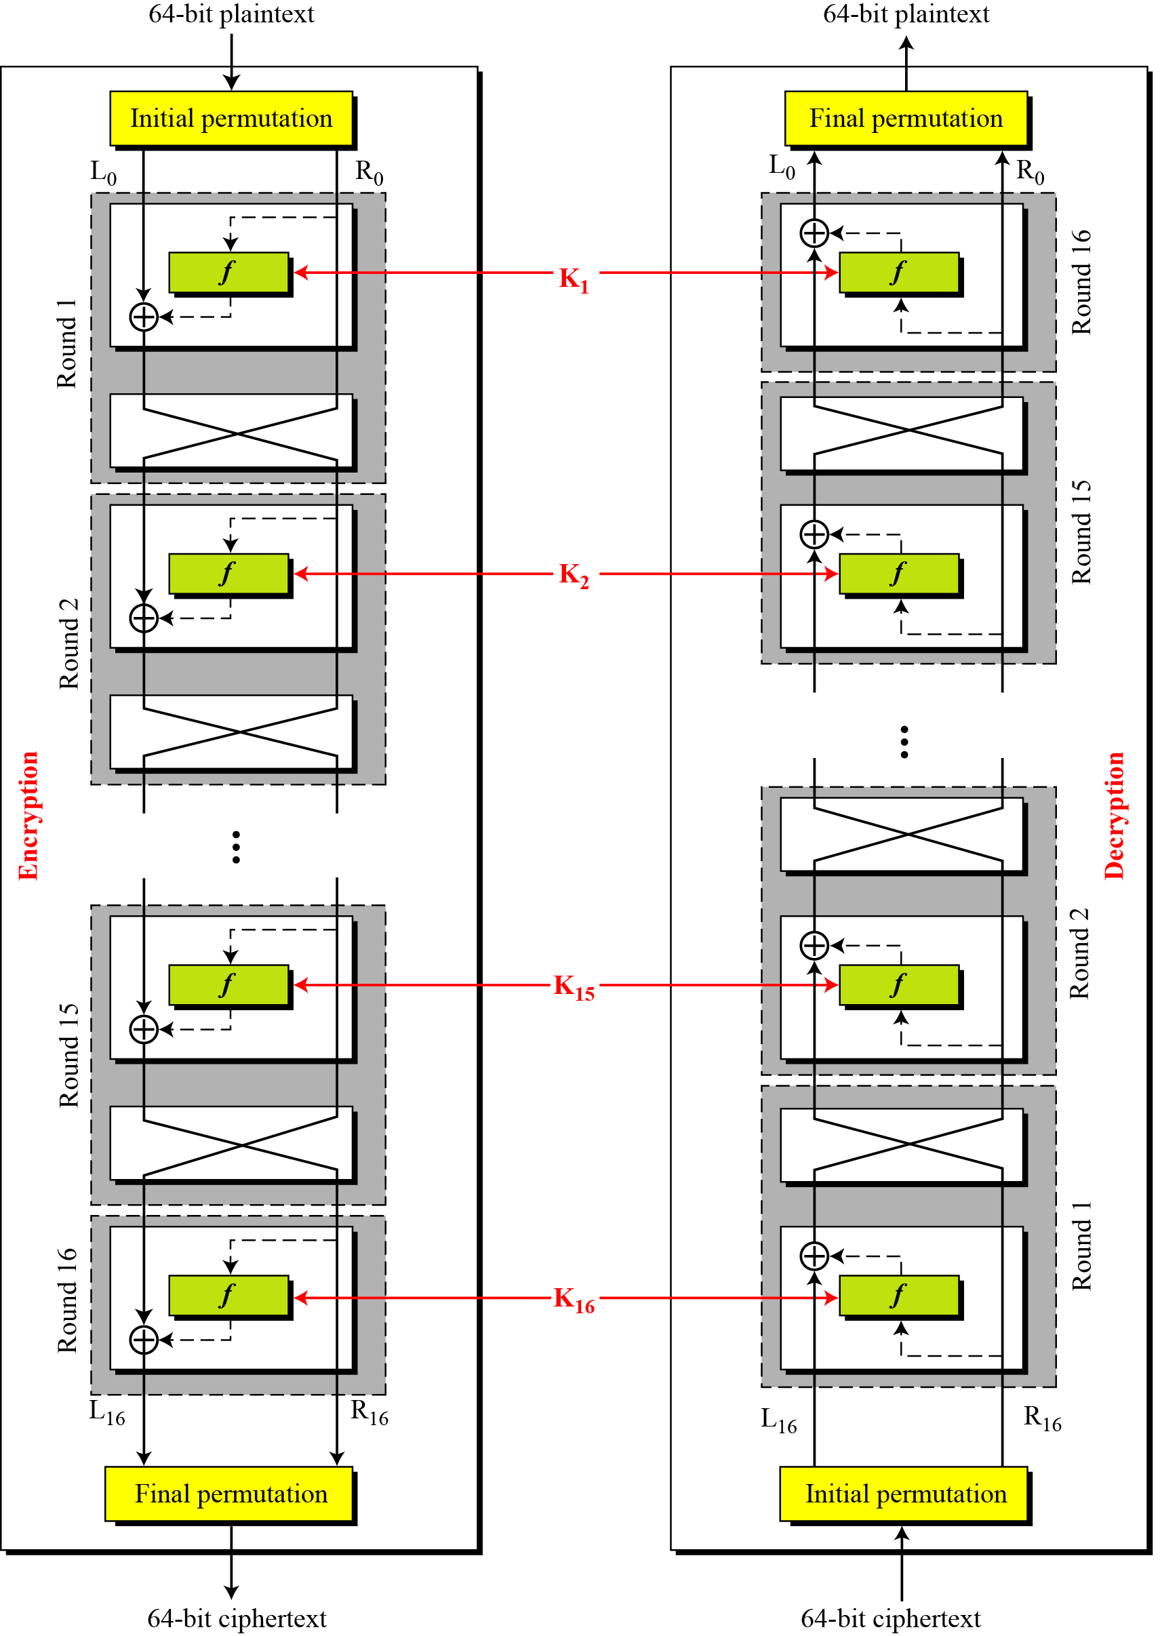
6.2.3 Continued
Figure 6.9 DES cipher and reverse cipher for the first approach

Slide 33
6.2.3 Continued
Alternative Approach
We can make all 16 rounds the same by including one swapper to the 16th round and add an extra swapper after that (two swappers cancel the effect of each other).
Key Generation
The round-key generator creates sixteen 48-bit keys out of a 56-bit cipher key.

Slide 34
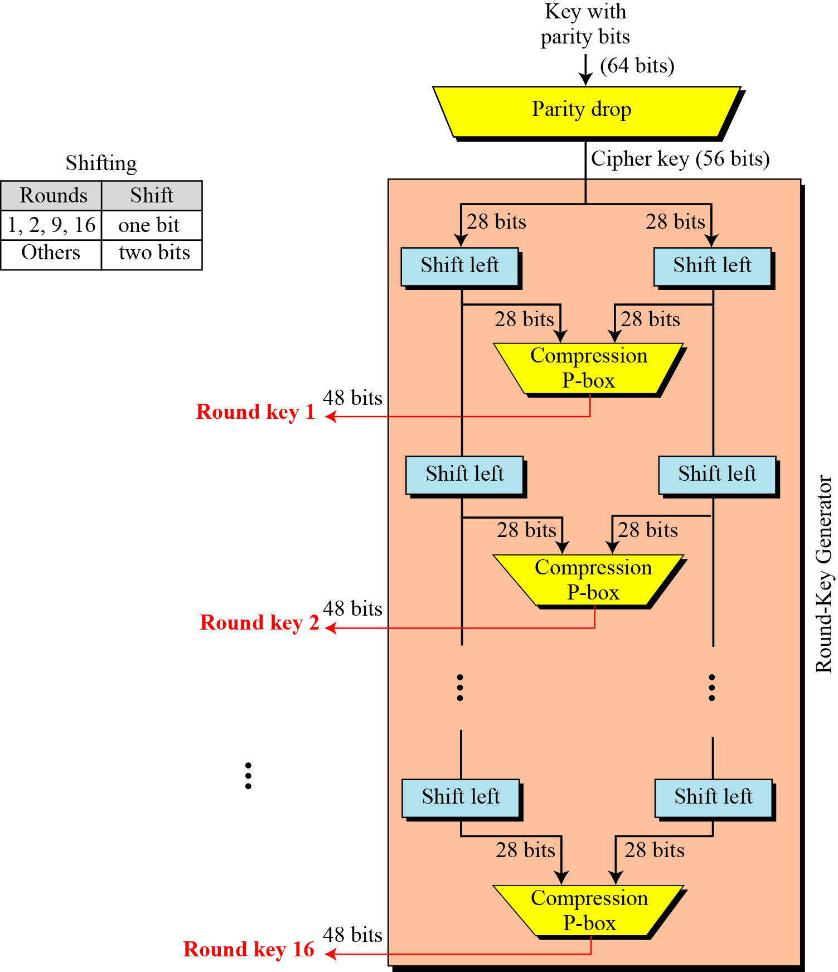
6.2.3 Continued
Figure 6.10 Key generation

Slide 35
6.2.3 Continued
Table 6.12 Parity-bit drop table
Table 6.13 Number of bits shifts

Slide 36
6.2.3 Continued
Table 6.14 Key-compression table

Slide 37
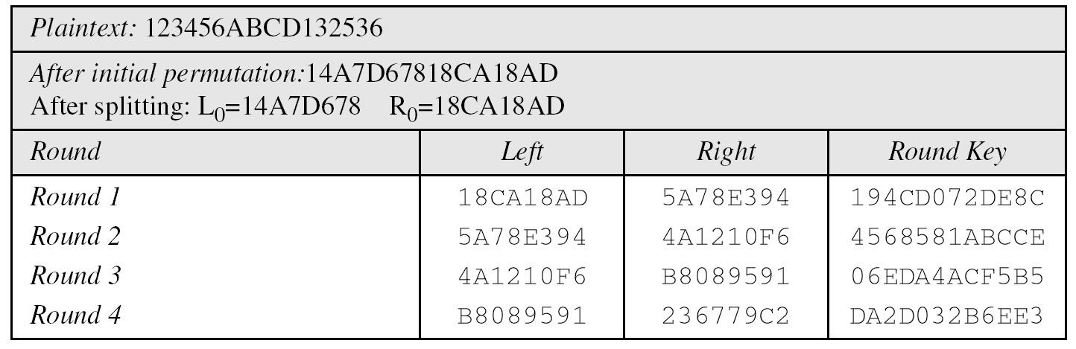
6.2.4 Examples
Example 6.5
We choose a random plaintext block and a random key, and determine what the ciphertext block would be (all in hexadecimal):
Table 6.15 Trace of data for Example 6.5

Slide 38
6.2.4 Continued
Example 6.5
Continued
Table 6.15 Trace of data for Example 6.5 (Conintued

Slide 39
6.2.4 Continued
Example 6.6
Let us see how Bob, at the destination, can decipher the ciphertext received from Alice using the same key. Table 6.16 shows some interesting points.

Slide 40
6-3 DES ANALYSIS
Critics have used a strong magnifier to analyze DES. Tests have been done to measure the strength of some desired properties in a block cipher.
Topics discussed in this section:
6.3.1 Properties 6.3.2 Design Criteria
6.3.3 DES Weaknesses

Slide 41
6.3.1 Properties
Two desired properties of a block cipher are the avalanche effect and the completeness.
Avalanche effect
Small change in plain text should create a significant change in ciphertext.
(Strong Avalanche effect → High diffusion)
Completeness effect
Completeness effect means that each bit of the ciphertext needs to depend on many bits on the plaintext.

Slide 42
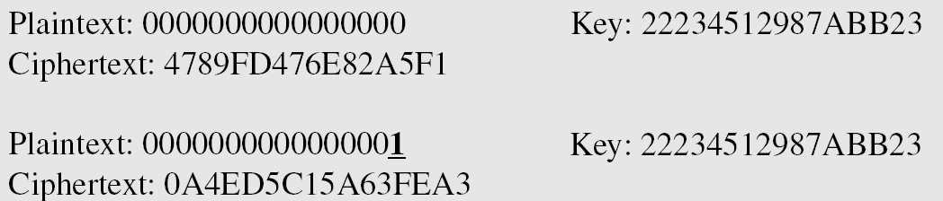
6.3.1 Properties
Example 6.7
To check the avalanche effect in DES, let us encrypt two plaintext blocks (with the same key) that differ only in one bit and observe the differences in the number of bits in each round.

Slide 43
6.3.1 Continued
Example 6.7
Continued
Although the two plaintext blocks differ only in the rightmost bit, the ciphertext blocks differ in 29 bits. This means that changing approximately 1.5 percent of the plaintext creates a
change of approximately 45 percent in the ciphertext.
Table 6.17 Number of bit differences for Example 6.7

Slide 44
6-4 Multiple DES
The major criticism of DES regards its key length. Fortunately DES is not a group. This means that we can use double or triple DES to increase the key size.
Topics discussed in this section:
6.4.1 Double DES 6.4.4 Triple DES

Slide 45
6.4.1 Double DES
The first approach is to use double DES (2DES).
Meet-in-the-Middle Attack
However, using a known-plaintext attack called meet-in-the-middle attack proves that double DES improves this vulnerability slightly (to 2⁵⁷ tests), but not tremendously (to 2¹¹²).

Slide 46
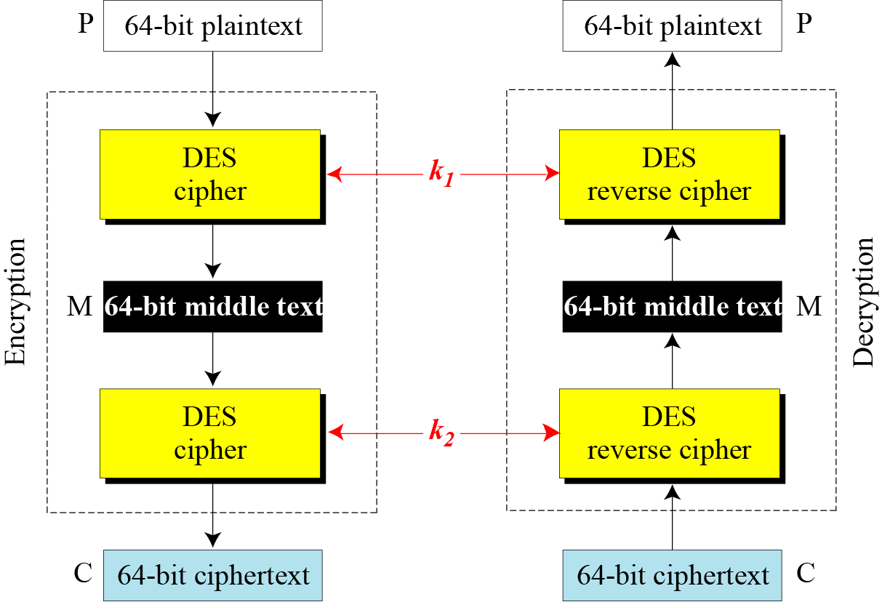
6.4.1 Continued
Figure 6.14 Meet-in-the-middle attack for double DES

Slide 47
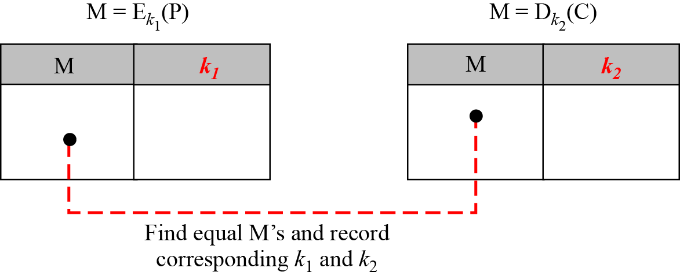
6.4.1 Continued
Figure 6.15 Tables for meet-in-the-middle attack

Slide 48
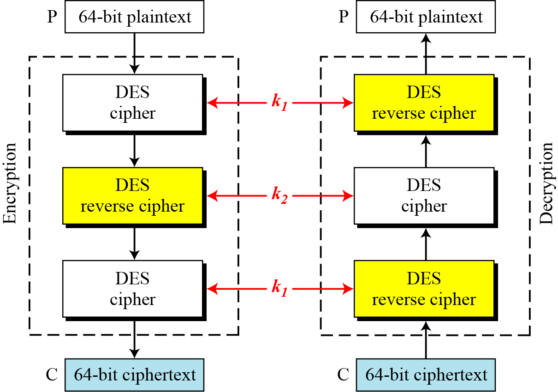
6.4.2 Triple DES
Figure 6.16 Triple DES with two keys

Slide 49
6.4.2 Continuous
Triple DES with Three Keys
The possibility of known-plaintext attacks on triple DES with two keys has enticed some applications to use triple DES with three keys.
Triple DES with three keys is used by many applications such as PGP.

